Slide 1
CS 490 PROJECT
Relational Database: Data Retrieval Using Java GUI
By: Avelino (Wave) Inguane &
Nicholas Wagner
Instructor: Pearl Wang
Notes:
For a group viewing your presentation on a large screen, you need to use a large font size so that anyone in the back row can easily see. Here is an example of one recommended format for Powerpoint presentations in classrooms or in meetings:
Title Text, Arial 40, bold, centered. Every slide should have its own title.
Section Headings, (narrative text), Arial 36, bold, left-justified.
Main text (narrative text), Arial 36, plain, left-justified.
Caption text, Arial 28, plain, centered directly under an image. (Using captions is optional.)
For a group presentation, never use a font size smaller than 28 point in a Powerpoint slide. People in the back row can't read small text.
For images, "crop" and resize your images to make it as easy as possible to see details.

Slide 2
Overview-Goals
What the project is about
Model doctor’s office appointment scheduling
Create a relational database to persist the data (SQL)
Goal: Implement java GUI that provides a simple way to retrieve data from a database

Slide 3
Overview-Goals
Problem
No Knowledge of SQL syntax to query the database
Be able to effectively formulate logical query statements
Etc.
Example: see next slide

Slide 4
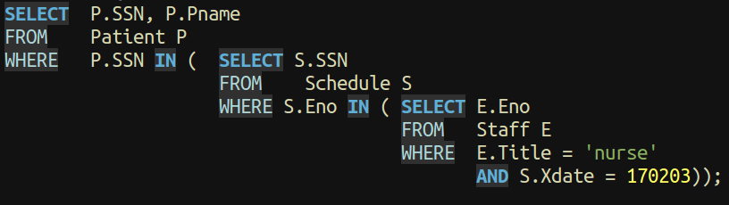
SQL Query Statement

Slide 5
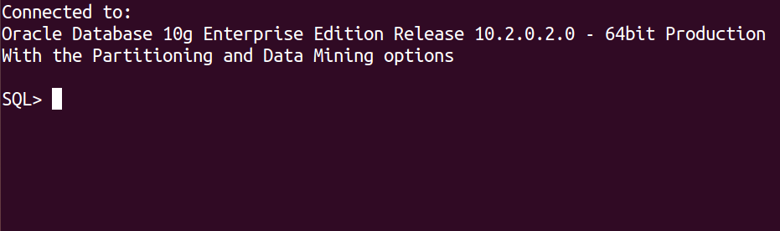
Problem

Slide 6
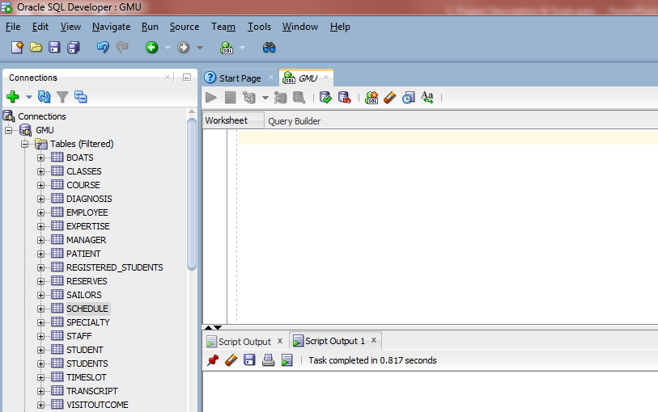
Problem

Slide 7

Overview-Goals
Goal
Provide a graphical user interface (GUI) to facilitate data retrieval from a database
Sample application feature
02/02/2017
patient
schedule
nurse

Slide 8


Team Organization-Division of Labor
Individual Project
One man show ?
If you like what you have had so far please join me to make it happen
https://encrypted-tbn2.gstatic.com

Slide 9
Technology
SQL (Zeus)
Persist Data
Java
Connect to Database
Query the Database
Provide the GUI
GitHub
Version control

Slide 10
Challenges-Issues
Grant permission
Make changes in the database
System Testing
Find Independent test team
What to test
Functional requirements
Load (stress)
Performance
Usability
Notes:
Testing page 42

Slide 11
Milestones-Schedule
Requirements specification Feb 17
Functional
What the software has to do
Nonfunctional
How well it should do it
Ex: Performance, Security, and Maintainability
Analysis Feb 24
Static modeling
Map objects to software classes
Provide a structural view of the system
Dynamic modeling
Integrations between objects
Provide behavioral view of the system
Notes:
Page 4: Static modeling provides a structural view of the system.
Classes are defined in terms of their attributes, as well as their relationships
with other classes. Dynamic modeling provides a behavioral view of the system.
Page 5: Nonfunctional requirements

Slide 12
Milestones-Schedule cont.
Design Mar 3
Decomposing the system into objects
Software design notation
Graphical (class diagrams)
Textual (pseudocode)
Implementation Mar 24
Incremental Development life cycle model
select system subsets for each increment
working system is available significantly earlier
Notes:
Implementation see page 34 read 3.1.4

Slide 13
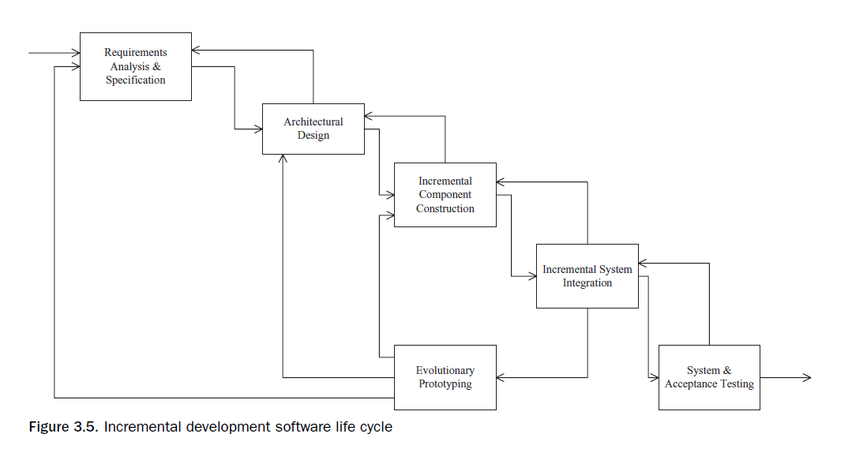
Incremental Development

Slide 14

Milestones-Schedule cont.
Testing
Unity Testing
Integration Testing
System Testing
Midterm Demo Apr 7
Maintenance
Final Demo Apr 21
Maintenance
Public Presentation May 5
Notes:
Testing read page 42

Slide 15
Thank you
Feedback
Comments
Join the project
Contact: Wave Inguane
(c)571-345-8960
ainguane@gmu.edu
https://friendlychat-278e9.firebaseapp.com/
Contributing (Fork repo)
>git clone https://github.com/wave-inguane/cs490project.git

Slide 16
Software Life Cycle
Requirements specification
Product use case model
Analysis
Product analysis model
Design
Design model and the deployment model
Implementation
Implementation Model
Testing
Test model
Maintenance
Notes:
See page 39
TODO: RUN GRAMMARLY
LISTEN TO THE PRESENTATION
PRACTICE – PRACTICE -- PRACTICE

